Slide 1

Swipe My Roomie
Team ALPHA

Slide 2
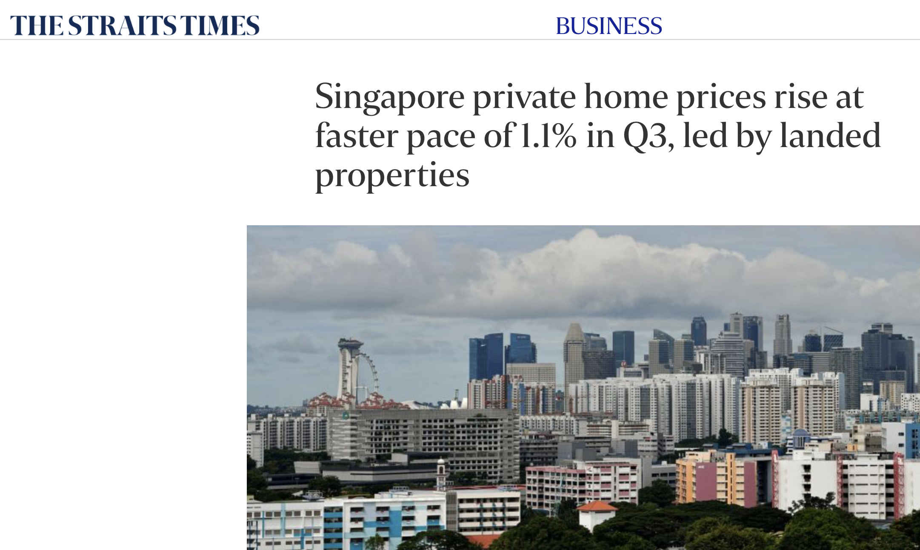
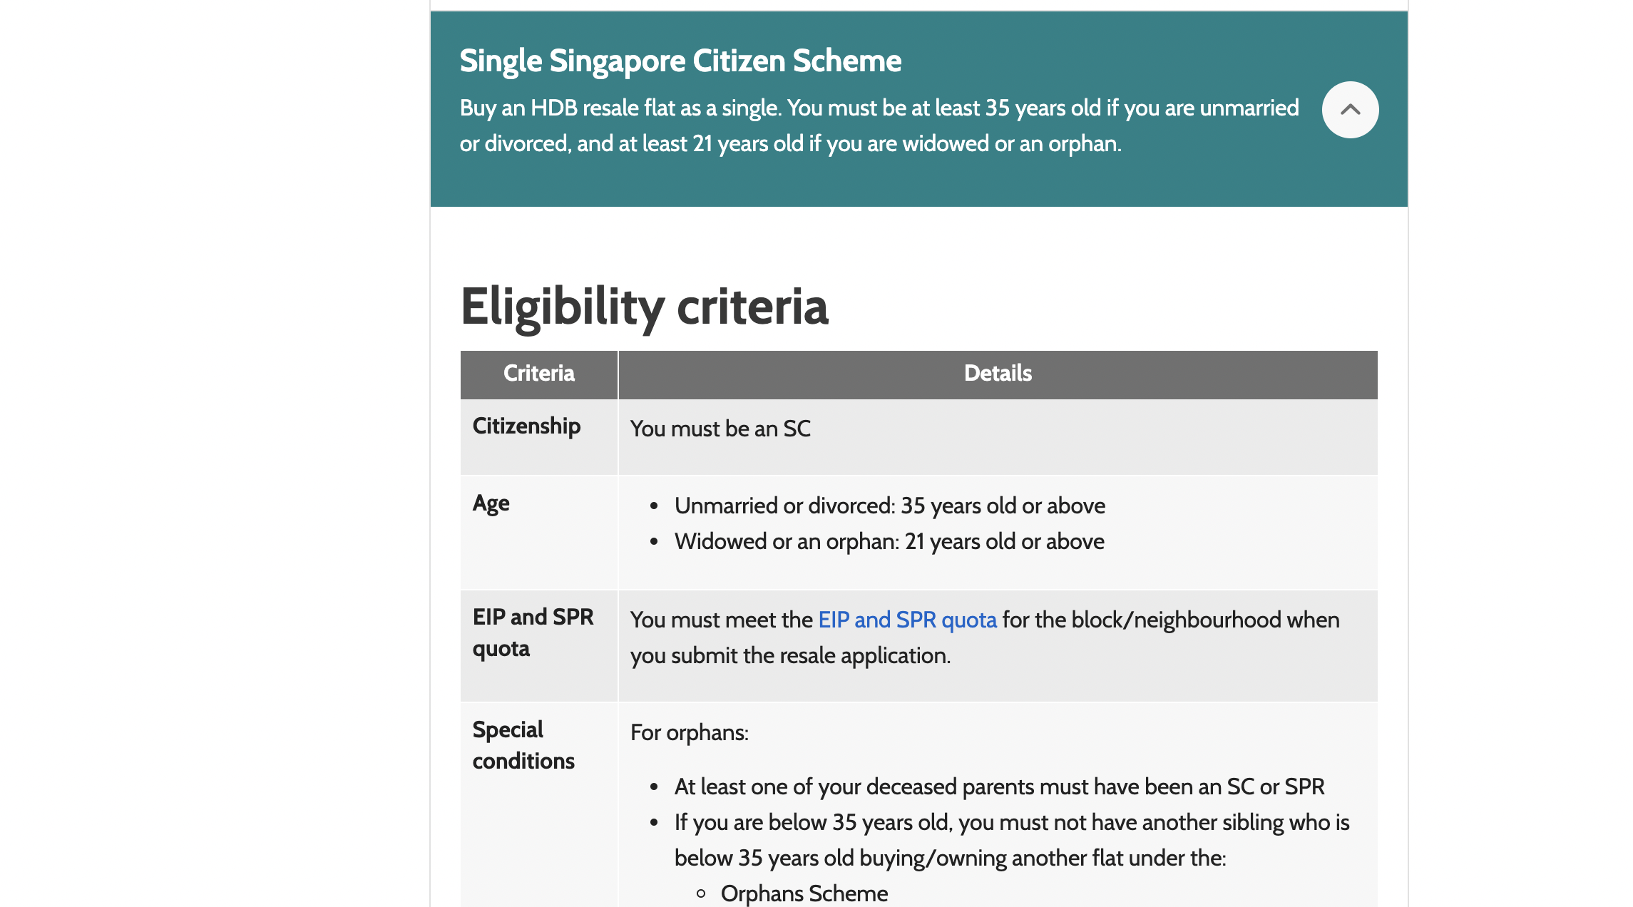
Introduction

Slide 3
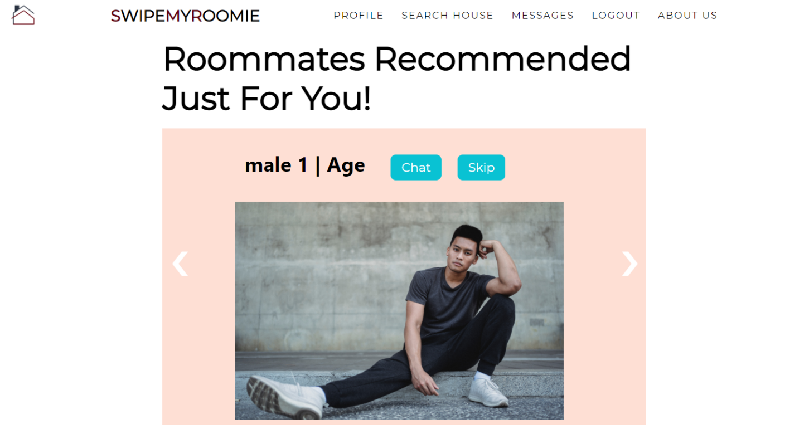
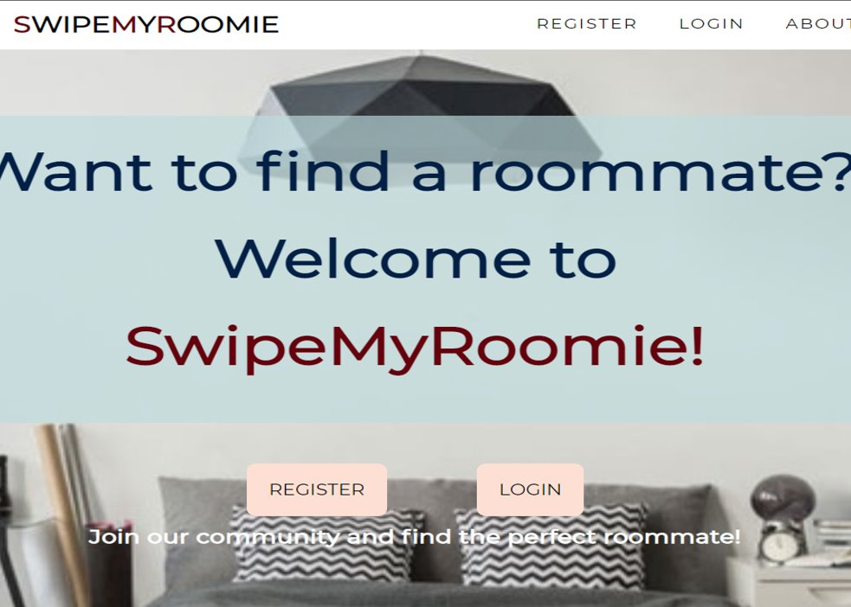
Website brought to you by team Alpha
To find compatible roommates in Singapore
Hassle free and affordable rental and living experience

Slide 4
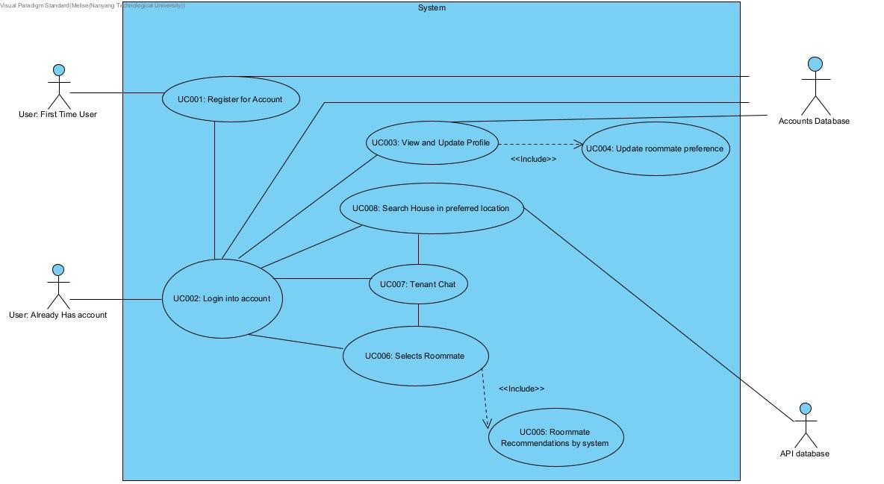
Use Case Diagram

Slide 5
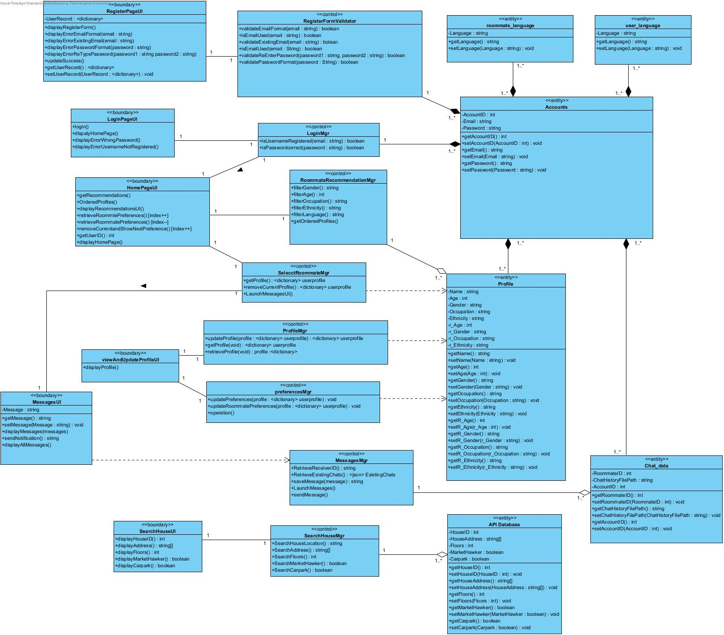
Class Diagram

Slide 6
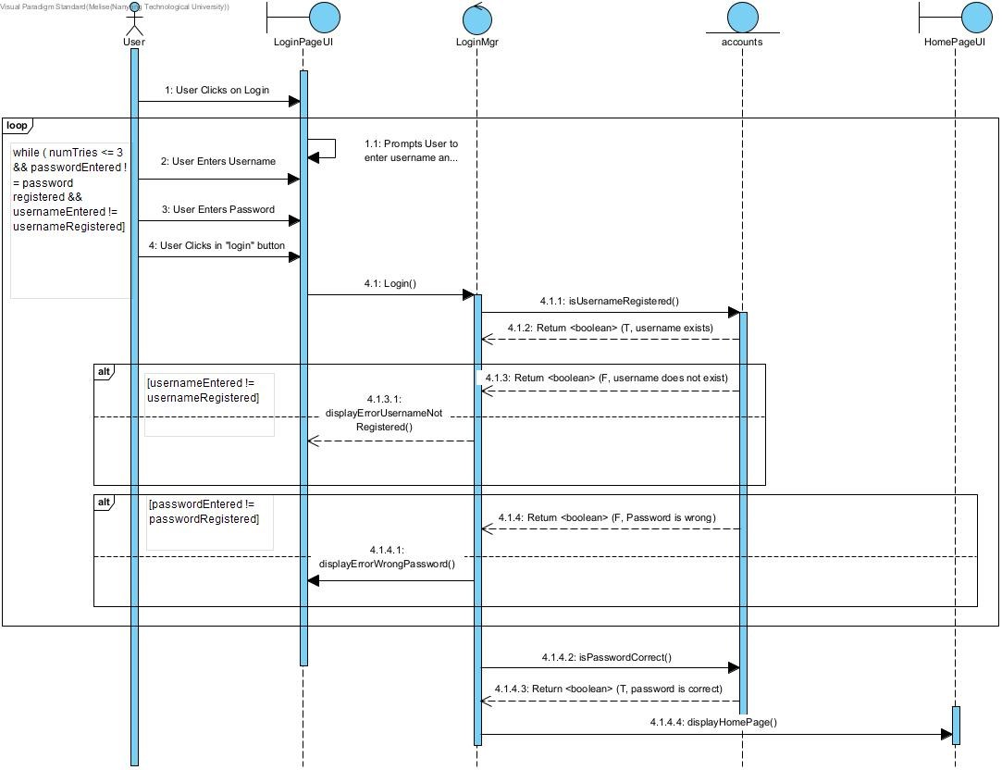
UC002: Login into account

Slide 7
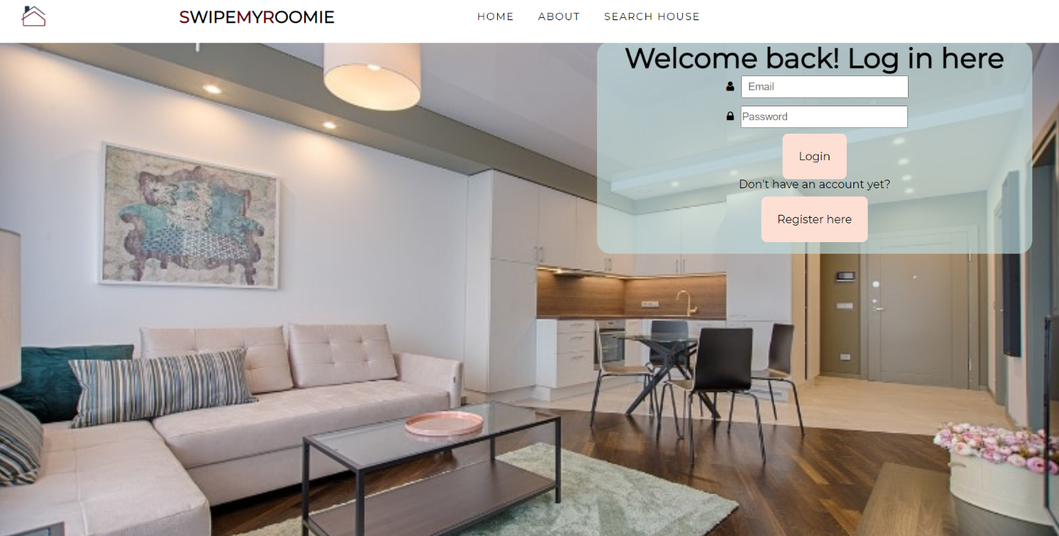
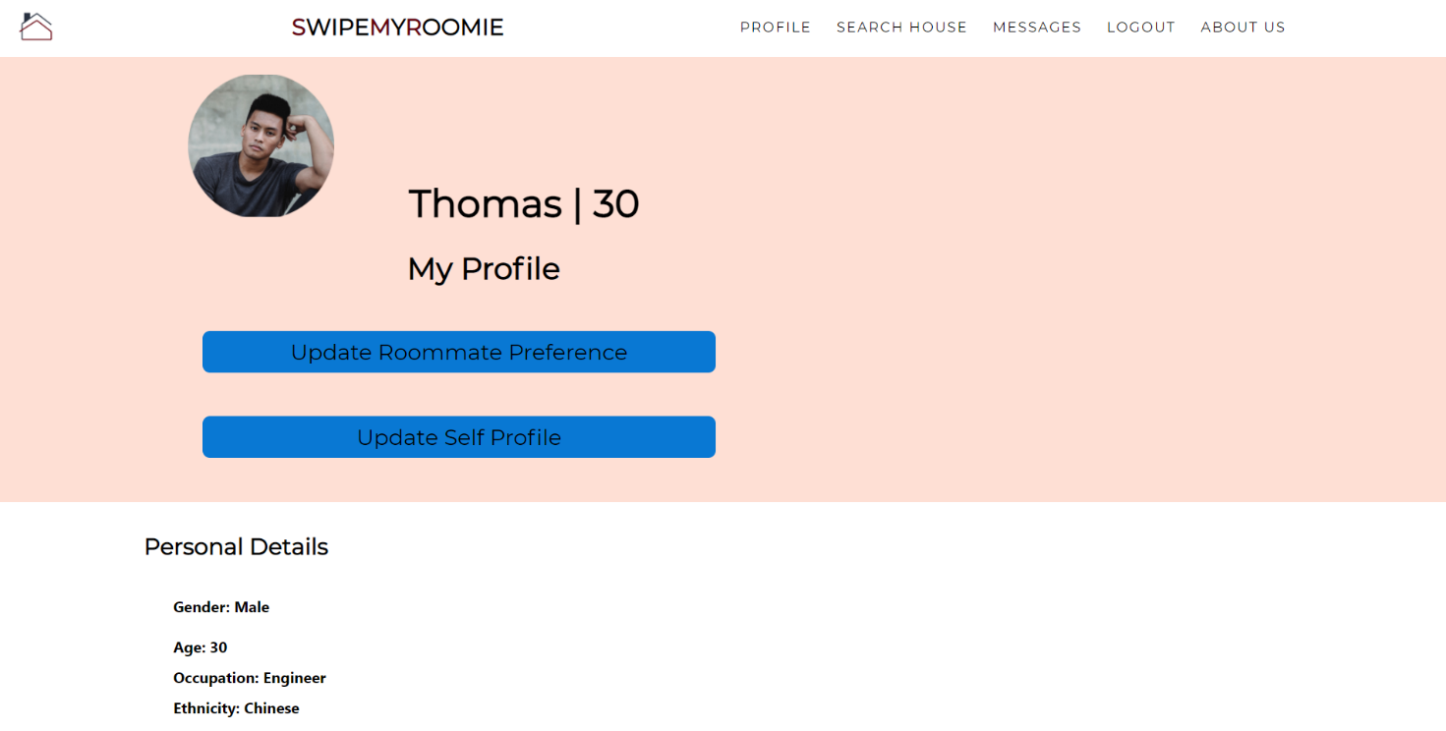
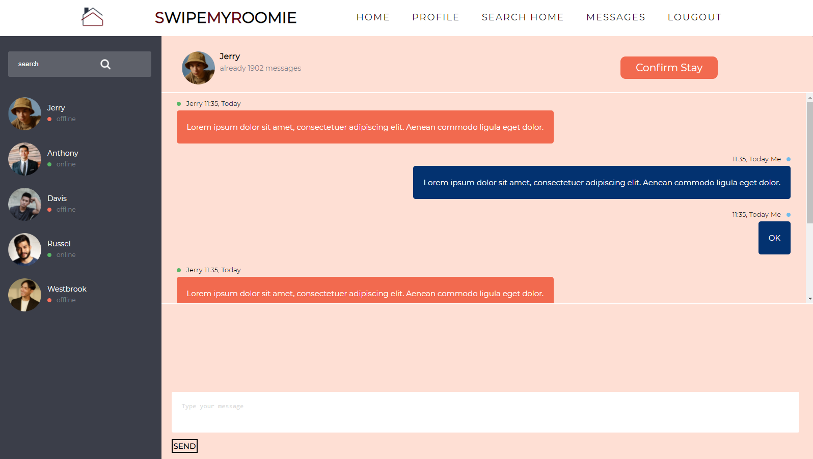
Main Features

Slide 8

Expected Users
University students
Young adults
Expats and immigrants

Slide 9
Live Demo here - 10 mins (includes slides 7,8,9,10)
walk through of the website – demonstrate ALL main features
Elaborate on testing in slide 10

Slide 10
Testing
Black box testing
White box testing
Automated testing

Slide 11












TECHNOLOGY STACK
FRONT-END
BACK-END
DATABASE
DEV OPS

Slide 12
Software Engineering practices applied
GitHhub – repository control for our source code
Google cloud – database
One drive –real-time collaboration and documentation
Visual Paradigm – for UML, architecture diagrams
provides support for further upgrades
Good traceability in source code and documentation

Slide 13
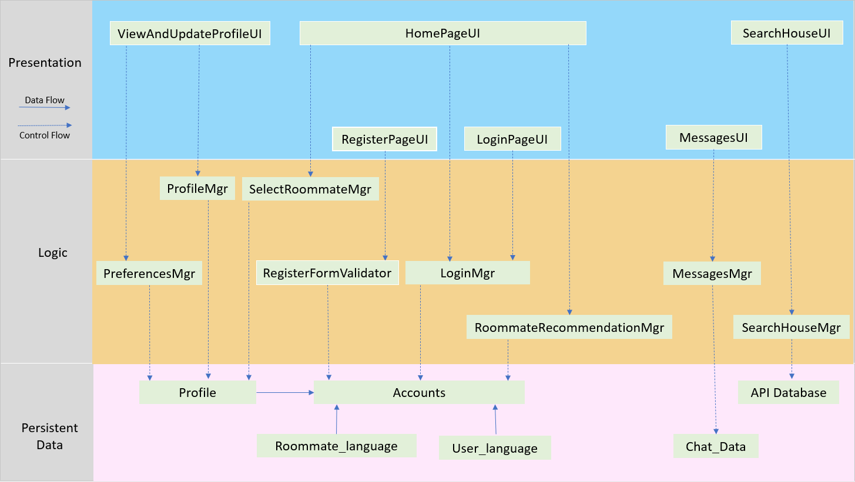
System Design
Fig: system architecture

Slide 14
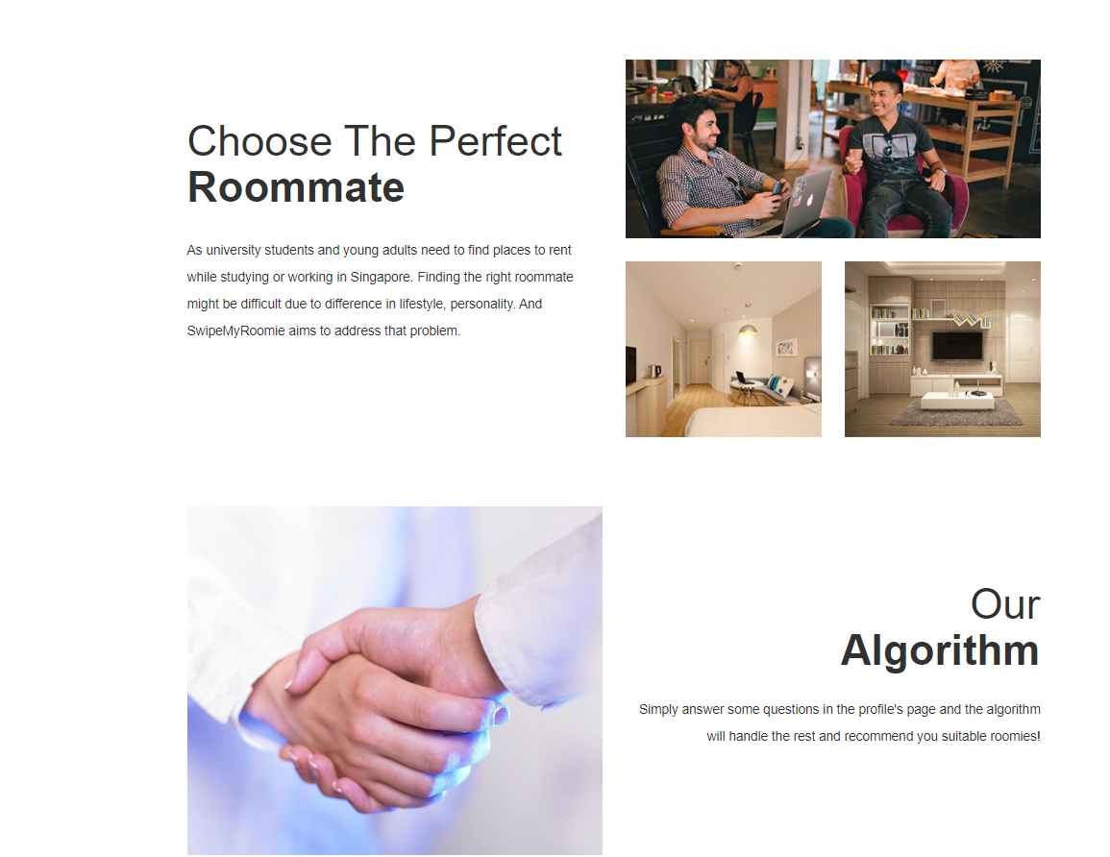
Conclusion

Slide 15
Thank You

